Slide 1
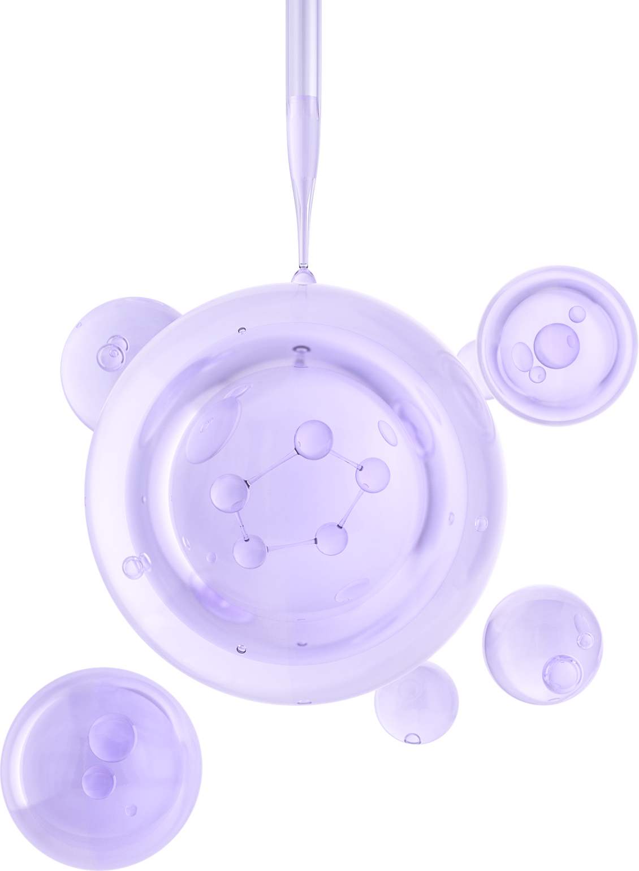

UNIVERSITY OF BASRAH / COLLEGE OF SCIENCE
LECTURE PhD. 1
Prokaryotic Cell Structure
Department of Biology
Prof.Dr. Saad S. Mahdi Al-Amara

Slide 2
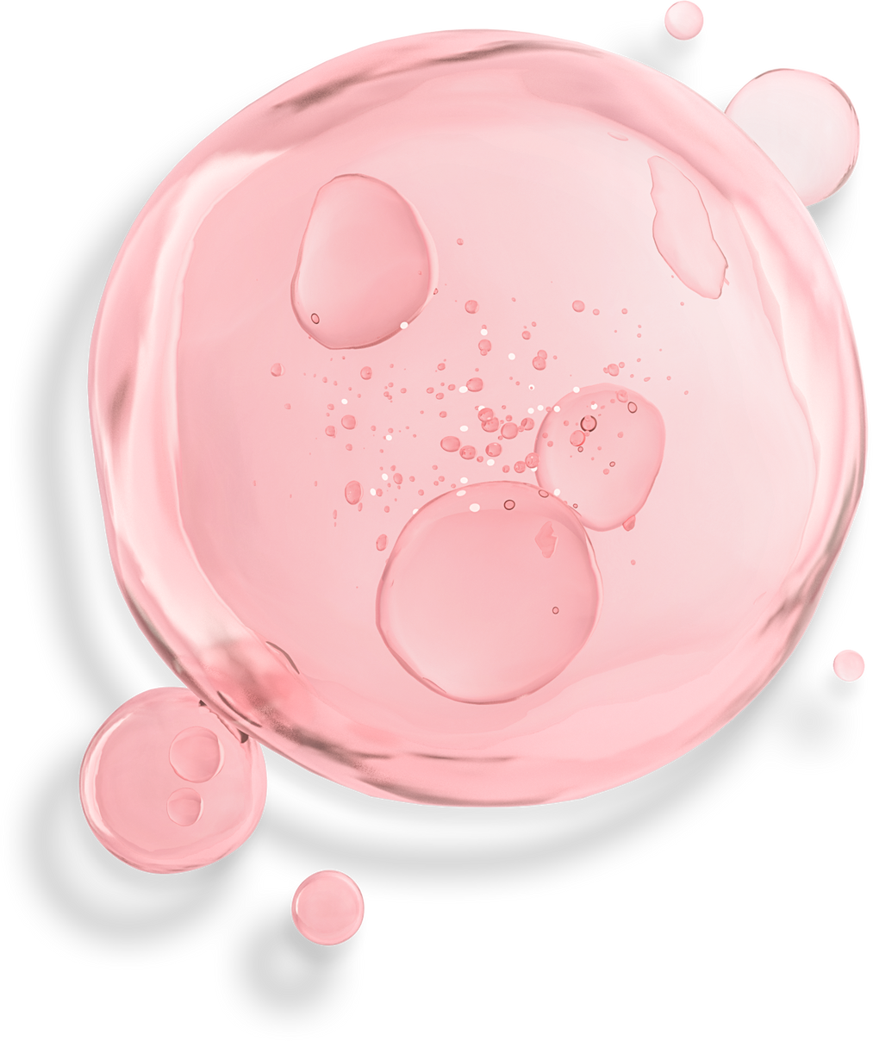
Prokaryotic Cell Surfaces
it was a high-molecular-weight, sugar-containing, rigid structure called peptidoglycan formed the major backbone of the murein sacculus of the cell wall of both gram-positive and Gram-negative bacteria.
Archaea produce a pseudomurein and an associated surface layer (S-layer) composed of protein or glycoprotein.
Surface Layers of Bacteria
        Bacteria from all of the major phylogenetic groups have been shown to produce a crystalline cell surface layer (S-layer) as the outermost component of the cell (Fig. 1-1) .
        S-layers are composed of identical protein or glycoprotein subunits.
        They assemble into two-dimensional crystalline arrays showing oblique, square, or hexagonal symmetry in gram-negative or gram-variable bacteria and are associated with the surface of the outer membrane

Slide 3
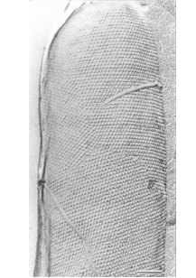
Fig. 1-1 Electron micrograph of a freeze-etched preparation showing a whole bacterial cell with a hexagonally ordered S-layer lattice. Bar equals 100 nm. (Source: From Sara, M. ˙
and Sleytr, U. B. J. Bacteriol. 182:859–868, 2000.)
The S-layer may appear quite different in various organisms. In gram-positive bacteria the subunits are linked to the peptidoglycan-containing layer or to secondary cell wall polymers attached to the peptidoglycan layer.
In B. sphaericus a specific cell wall polymer has been characterized, It contains N-acetylglucosamine, N-acetylmannosamine, and pyruvic acid and serves as the specific binding site for the N-terminal portion of the S-layer protein

Slide 4
Chemical analysis of purified S-layers shows that they are composed of a single protein or glycoprotein species.
In a few organisms, such as Clostridium dificile or B.anthracis, two types of subunits are observed.
S-layers often contain a high proportion of acidic and hydrophobic amino acids. Lysine is the predominant basic amino acid, Arginine, histidine, and methionine are generally
Diverse functions have been attributed to the S-layer
1. Mediation of bacterial attachment to surfaces and to host tissues.
2. Serves as a virulence factor in Campylobacter and Aeromonas .
3. represents the outermost layer external to the cell membrane in archaea, it contribute substantially to the shape of the cell (as in Thermoproteus tenax).

Slide 5
Peptidoglycans of Bacterial Cell Walls
Peptidoglycan :
is a heteropolymer of repeating units of β-1,4-N-acetylglucosamine (NAG) and N-acetyl-muramic acid (NAM).
The glycan linkages of peptidoglycan are considered to be uniform in all bacteria with every D-lactyl group of the NAM being peptide substituted.
All glycans have short tetrapeptide units terminating with D-alanine or occasionally tripeptide units lacking the terminal D-alanine. The L-alanine at the N-terminus can be replaced by glycine.

Slide 6
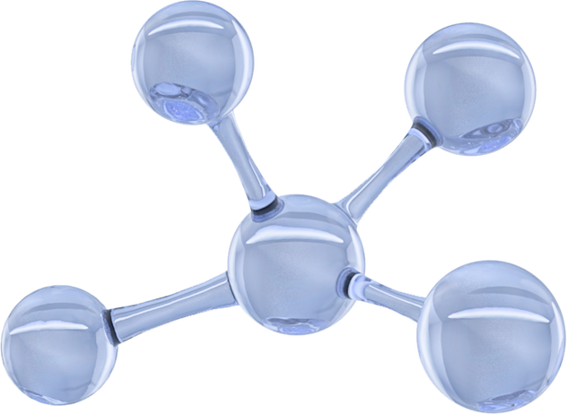
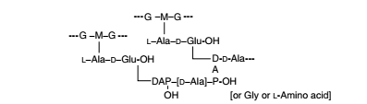
The interpeptide bridges linking peptidoglycans are of four major types
Type I. Direct D-alanyl-R3 peptide bond.
Found in E. coli and most other gram-negative bacteria; may be found in many bacilli.

Slide 7
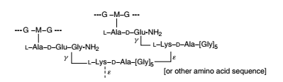
Type II. Pentaglycine or other L- or D-amino acid sequence.
This type of interpeptide bridge varies from organism to Staphylococcus aureus and Staphylococcus epidermidis

Slide 8

Type III. Bridge composed of one to several peptides, each having
The same amino acid sequence as the peptide unit attached to muramic acid; found in Micrococcus luteus .

Slide 9
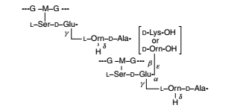
Type IV. Bridge extending between carboxyl groups
belonging to either D-alanine or to D-glutamate and a diamino acid residue or
a diamino acid- containing short peptide; found in B. rettger

Slide 10
THANK YOU

